Slide 1
Final Presentation
Pablo de Vicente

Slide 2
Research Question
What recommendations do we get from different training algorithms?
RECPACK

Slide 3
Research Plan
Define algorithms to use
Popularity
ItemKNN
KUNN
Evaluate a set of metrics in recommended articles
We’ll look into this in a minute
Compare results
You are going to get tired of graphs

Slide 4
Characteristics observed
Category of clothes ( Men / Women / Sports …)
Color of clothes
Price of items recommended
Fabrics used
Frequency of recommended items
Important for Popularity algorithm
Notes:
Count transactions for each customer

Slide 5
Timeline
20 - 09 - 2018
22 - 09 - 2020
Notes:
Count transactions for each customer

Slide 6
Timeline
20 - 09 - 2018
22 - 09 - 2020
7 - 07 - 2020
15 - 09 - 2020
Notes:
Count transactions for each customer

Slide 7
Timeline
20 - 09 - 2018
t
22 - 09 - 2020
DELTA_IN = 10 WEEKS
DELTA_OUT = 1 WEEK
7 - 07 - 2020
15 - 09 - 2020
Notes:
Count transactions for each customer

Slide 8
Timeline
20 - 09 - 2018
t
22 - 09 - 2020
DELTA_IN = 10 WEEKS
DELTA_OUT = 1 WEEK
7 - 07 - 2020
15 - 09 - 2020
Test = t - delta_in
Validation = t + delta_out
Notes:
Count transactions for each customer

Slide 9
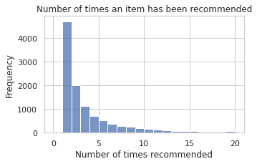
ITEMKNN
'K': [100, 200, 500]
'similarity': ['cosine', 'conditional_probability']
ARTICLES : 105.542
CUSTOMERS : 45.000
NUMBER OF RECOMMENDED ARTICLES : 11.256 (~10%)
Notes:
Count transactions for each customer

Slide 10
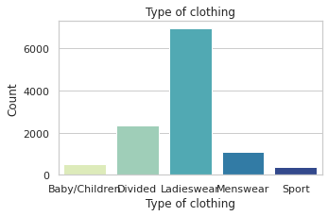
ITEMKNN
'K': [100, 200, 500]
'similarity': ['cosine', 'conditional_probability']
Type of clothes
Normalized
Color
Grouped colors
Autumn colors
Fabric
Price
Notes:
Count transactions for each customer

Slide 11
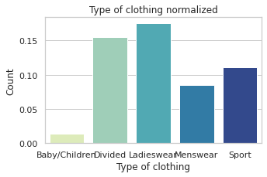
ITEMKNN
'K': [100, 200, 500]
'similarity': ['cosine', 'conditional_probability']
Type of clothes
Normalized
Color
Grouped colors
Autumn colors
Fabric
Price
Notes:
Count transactions for each customer

Slide 12
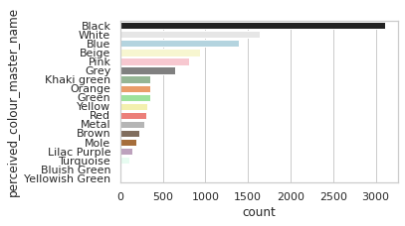
ITEMKNN
'K': [100, 200, 500]
'similarity': ['cosine', 'conditional_probability']
Type of clothes
Normalized
Color
Grouped colors
Autumn colors
Fabric
Price
Notes:
Count transactions for each customer

Slide 13
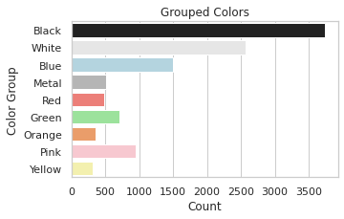
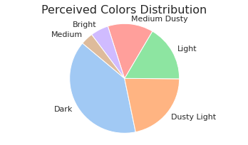
ITEMKNN
'K': [100, 200, 500]
'similarity': ['cosine', 'conditional_probability']
Type of clothes
Normalized
Color
Grouped colors
Autumn colors
Fabric
Price
Notes:
Count transactions for each customer

Slide 14
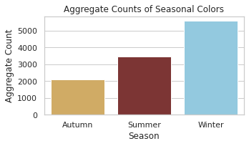
ITEMKNN
'K': [100, 200, 500]
'similarity': ['cosine', 'conditional_probability']
Type of clothes
Normalized
Color
Grouped colors
Autumn colors
Fabric
Price
Notes:
Count transactions for each customer

Slide 15
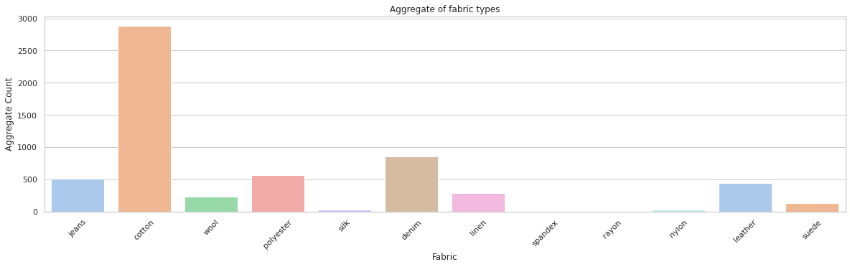
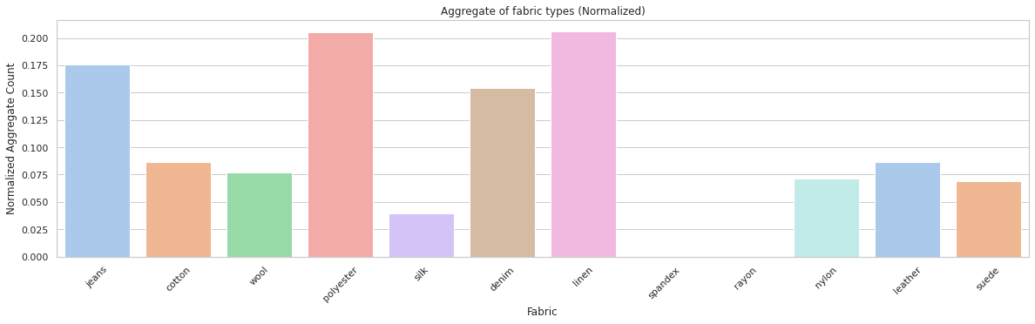
ITEMKNN
'K': [100, 200, 500]
'similarity': ['cosine', 'conditional_probability']
Type of clothes
Normalized
Color
Grouped colors
Autumn colors
Fabric
Price
Notes:
Count transactions for each customer

Slide 16
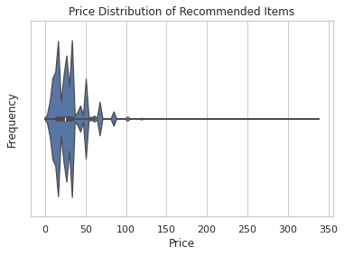
ITEMKNN
'K': [100, 200, 500]
'similarity': ['cosine', 'conditional_probability']
Type of clothes
Normalized
Color
Grouped colors
Autumn colors
Fabric
Price
*I made up the values. Multiplied originals by a constant C = 1000
Notes:
Count transactions for each customer

Slide 17
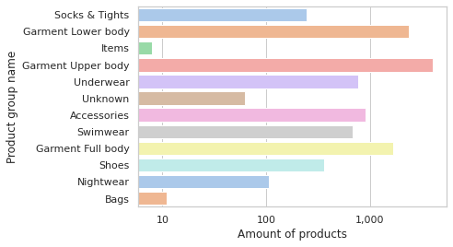
ITEMKNN - Conclusion
Hates babies : Understandable
Likes Linen & Polyester & Jeans: Maybe likes recommending pants?
Notes:
Count transactions for each customer

Slide 18
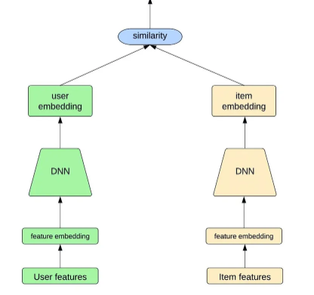
KUNN - Where things start to fall apart
KUNN : Hybrid similarity algorithms use a combination of user and item similarities to generate recommendations.

Slide 19
Timeline
As computer requirements where too much i tried to reduce the data
+1 week
20 - 09 - 2018
t
22 - 09 - 2020
7 - 07 - 2020
15 - 09 - 2020
I eventually managed to run the model, but the results were not consistent or repeatable.
Notes:
Count transactions for each customer

Slide 20
POPULARITY
Intended to serve as a baseline
ARTICLES : 105.542
CUSTOMERS : 45.000
NUMBER OF RECOMMENDED ARTICLES : 3

Slide 21
POPULARITY
Intended to serve as a baseline
ARTICLES : 105.542
CUSTOMERS : 45.000
NUMBER OF RECOMMENDED ARTICLES : 3

Slide 22
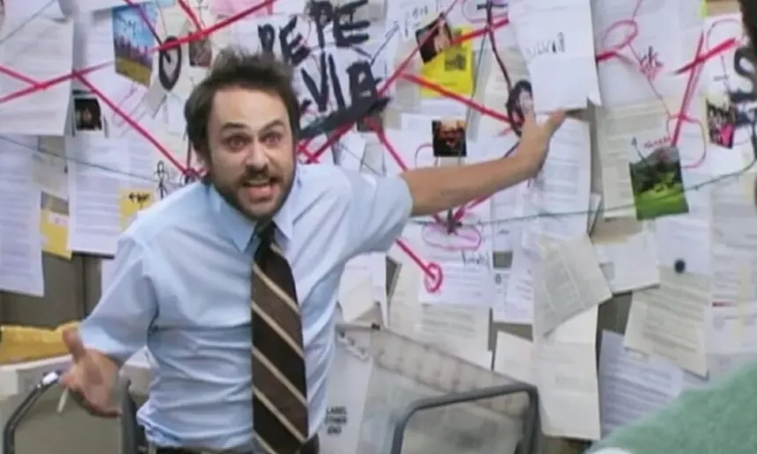
Conclusions
Research plan:
ITEMKNN - Worked best
Popularity - Too popular
KUNN - Not enough computing power
Personal notes:
Its harder than expected to find relations in data
Recpack was nice to work with
At least i learned to work with seaborn and matplotlib

